Slide 1




Facial Verification
Kaiwen Dai, Zepng Zhang Team 13

Slide 2
Overview
1.Use Cases
2.Goals
3.Methodogy
4.Image Classify
5.Facial Verification
6.Results
7.Acceptance Criteria

Slide 3
Use Cases
System runs data model to tell who is in the picture for already known person
Matching the new image
Goals

Slide 4


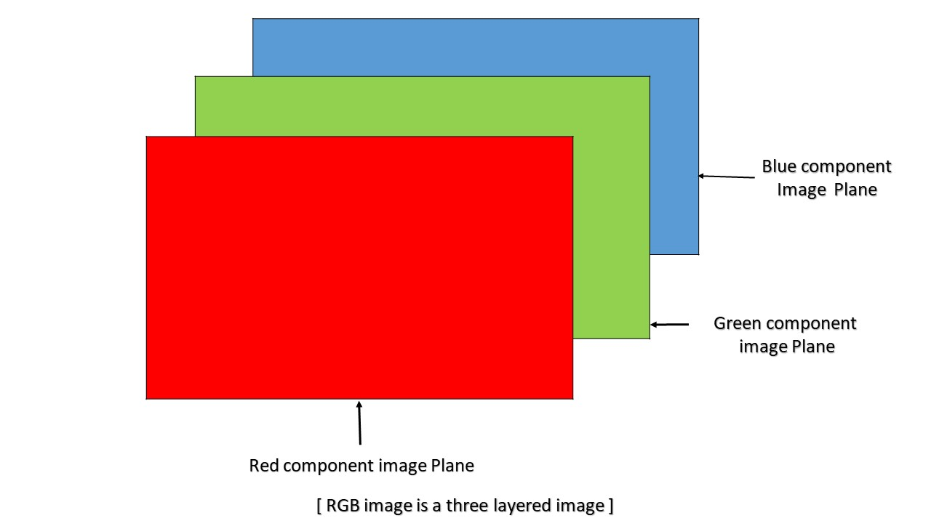
Methodology
Image Process,CNN, Facial Verification
How a Computer Reads an Image
R
z
B
G

Slide 5
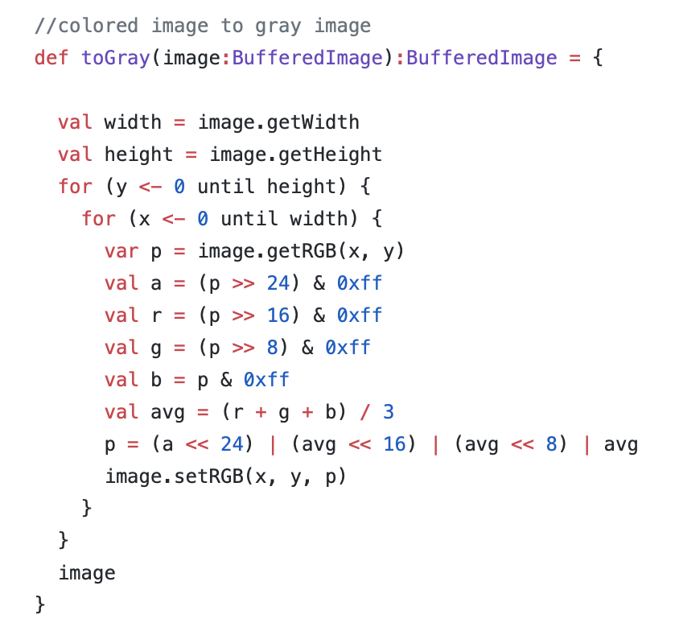
Turn Colored Image to Grey
1.Get the RGB value of the pixel
2.Find the average of RGB
3.Replace R, G and B values of the pixel with average of RGB
4.Repeat for each pixel of image

Slide 6
Convolutional Neural Network
Convolutional Neural Network is a type of feed-forward artificial neural network which is inspired by actual animal cortex.
Visual cortex is small regions of cells that are sensitive to specific regions of visual field. For example, some cells are activated by exposing to vertical edges;
Three Layers

Slide 7
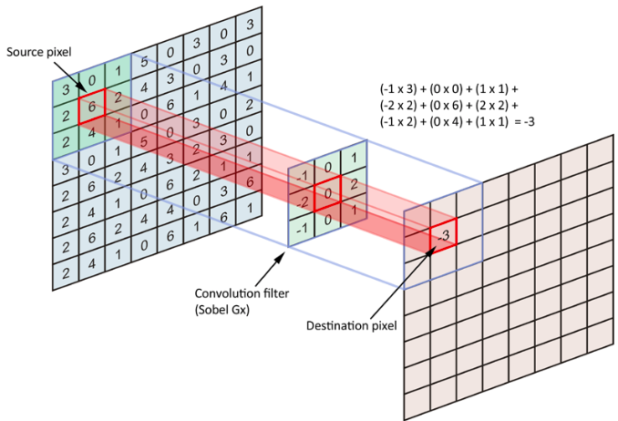
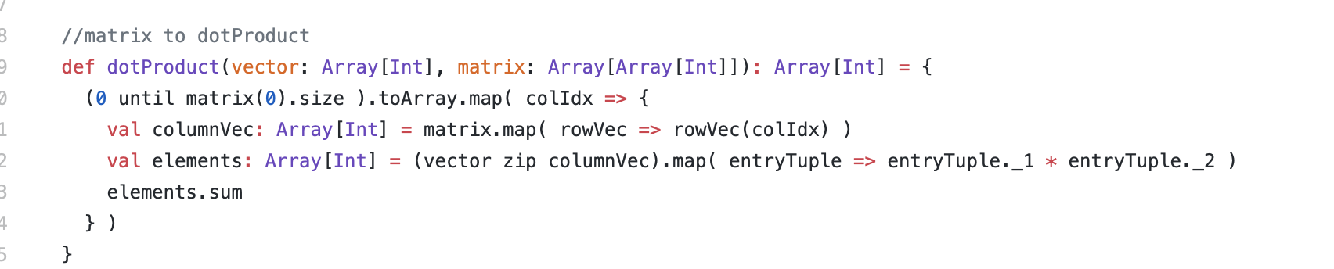
Convolutional Layer
Choose Conv2D there . Because image is 50*50 and 3 channels
z

Slide 8
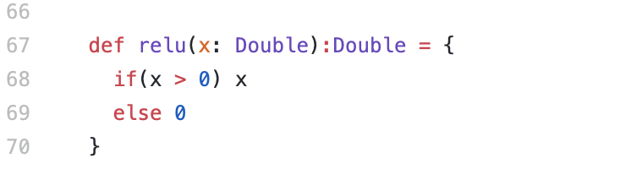
Activation Layer
z
Relu

Slide 9
Pooling Layer
Max Pooling with strides of 1 and kernel size of 2

Slide 10

Result and Data Sources
Number of images is 10000
Number of classes is 13
All images from: http://mmlab.ie.cuhk.edu.hk/projects/CelebA.html

Slide 11
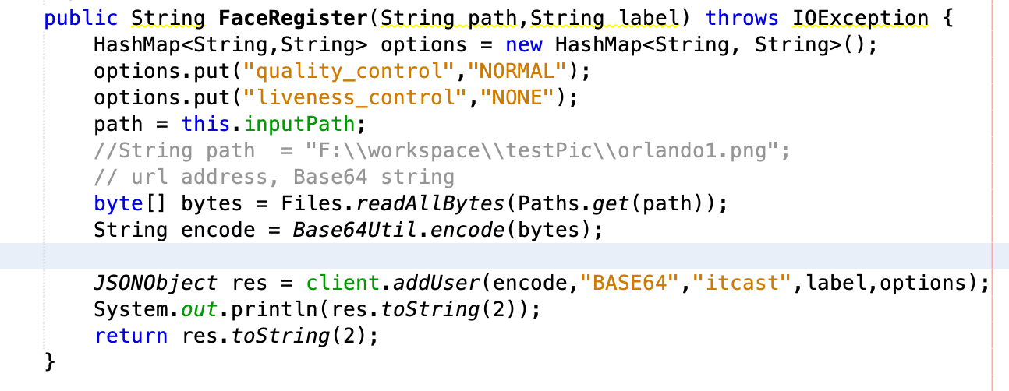
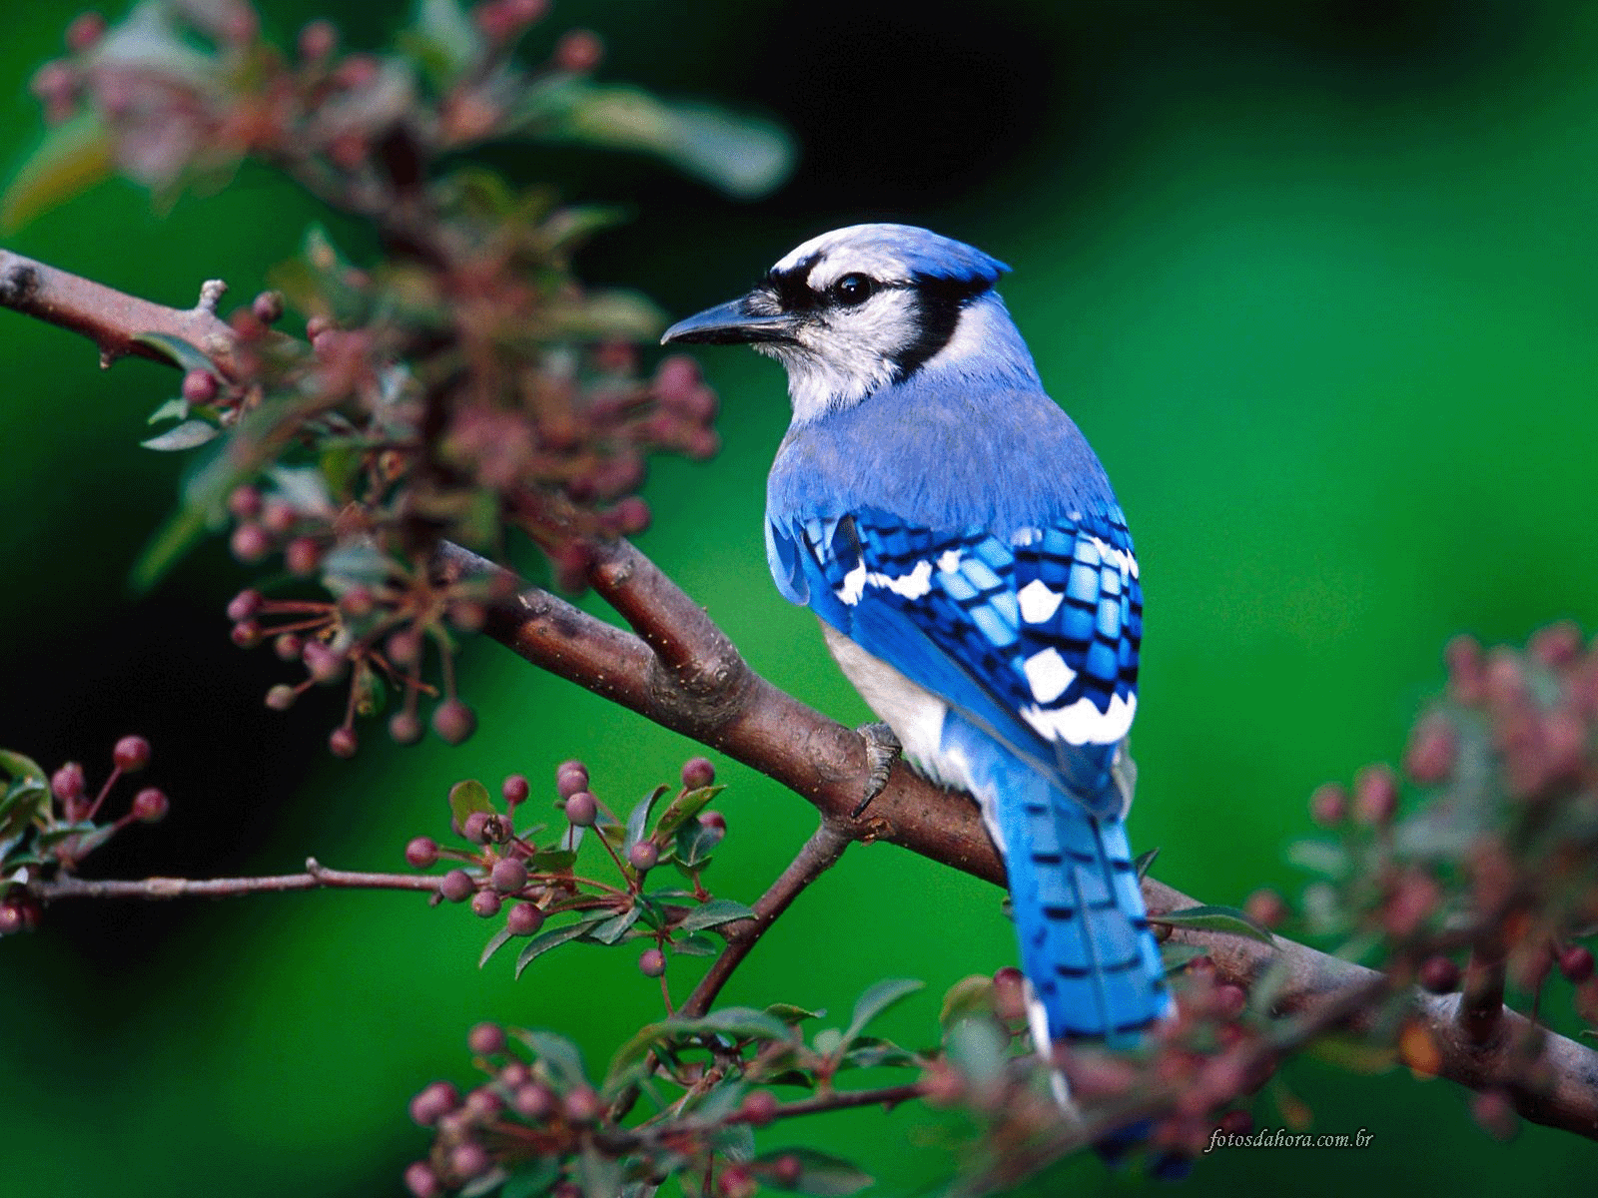
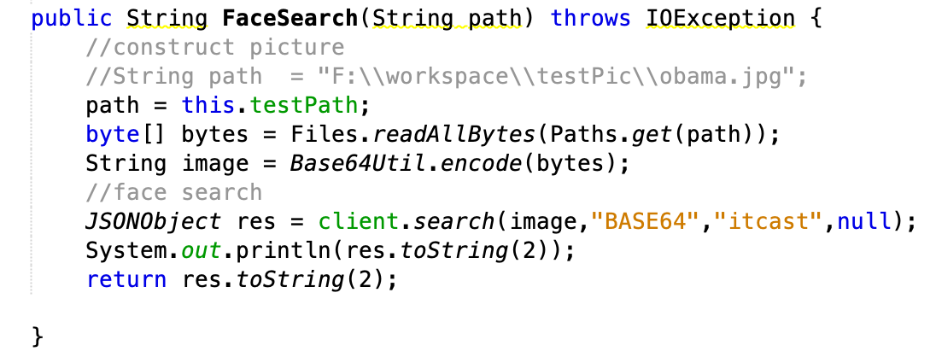
Demo for Facial Verification Part
Input Image and Output Result

Slide 12
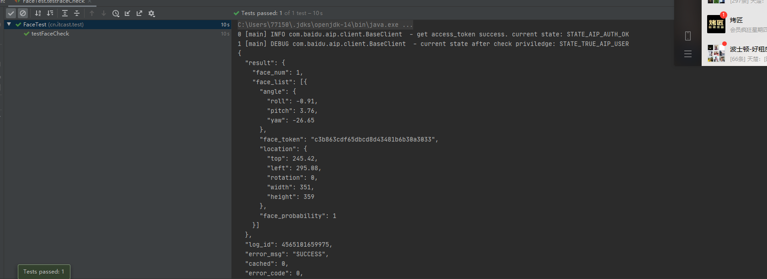


Acceptance Criteria
To make accuracy of our model higher than 90% or even more
The time to respond within 5 seconds

